Slide 1
Active Feature Acquisition on Data Streams Tutorial @ IE2025
Dr.-Ing. Christian Beyer | 24.06.2025
christian.beyer@ovgu.de
Notes:
Multi-Task Learning → partly true, →do not share structure unless ensemble → different training data but same task
Recommenders rely user-user or item-item similarities. -> ignored
Recommenders often aggregate data across entities. ->not yet.
Recommenders seek cross-entity generalization (e.g., new users/items).
Entity-centric learning focuses on intra-entity generalization, avoiding global patterns.

Slide 2
Content
Background on Active Feature Acquisition (30min)
Introduction to the Framework (10min)
Coding Exercises 1 (20min)
Coffee Break (30min)
Coding Exercises 2 (20-30min)
Presentation of Solutions and Discussion (20min)

Slide 3

Problems when Features are Missing
Missing features are common (patients, sensors, questionnaires…)
Most classifiers need feature complete instances to do predictions
Prediction quality suffers if important features are missing → Guess missing features (imputation) → Acquire features for a cost (AFA)
[gpt-4o]
Notes:
Maybe explain active learning briefly

Slide 4

Cost-aware active feature acquisition (AFA)
Which sensor
should I fix next?
Consider scenarios where missing feature values can be acquired for a cost
The missing data is simulated to be missing completely at random
Subfield of active learning
[https://www.vaisala.com/en/blog/2024-01/common-humidity-measurement-problems-and-how-avoid-them]
Notes:
Add missingness overview slide to backup

Slide 5
Cost-aware active feature acquisition (AFA)
Complete Data
Consider scenarios where missing feature values can be acquired for a cost
The missing data is simulated to be missing completely at random
Subfield of active learning
Age | Weight | Blood Type | Smoker | Class
24 | 68 | A | yes | pos
38 | 74 | B | no | pos
61 | 71 | AB | no | neg
55 | 90 | AB | no | pos
17 | 60 | B | yes | neg
47 | 84 | 0 | yes | neg
39 | 81 | A | no | pos
Notes:
Add missingness overview slide to backup

Slide 6
Cost-aware active feature acquisition (AFA)
50% Missing MCAR
Consider scenarios where missing feature values can be acquired for a cost
The missing data is simulated to be missing completely at random
Subfield of active learning
Age | Weight | Blood Type | Smoker | Class
x | 68 | x | x | pos
38 | x | B | no | pos
x | x | AB | x | neg
x | 90 | x | x | pos
17 | 60 | B | yes | neg
x | 84 | x | yes | neg
39 | x | A | x | pos
Notes:
Add missingness overview slide to backup

Slide 7
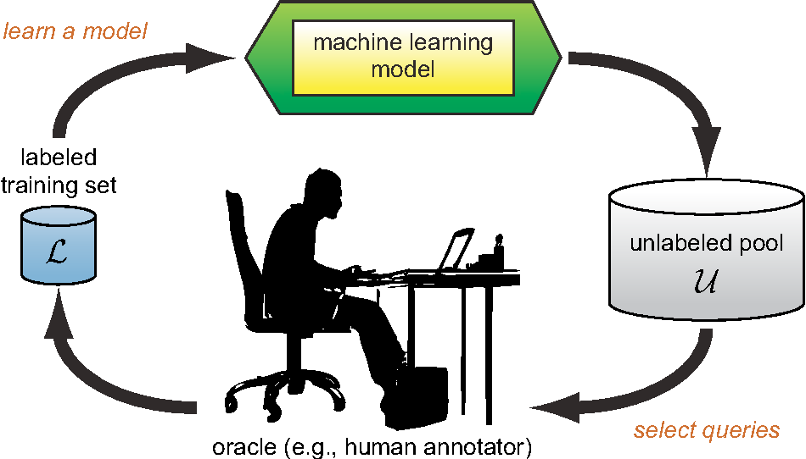
Cost-aware active feature acquisition (AFA)
Consider scenarios where missing feature values can be acquired for a cost
The missing data is simulated to be missing completely at random
Subfield of active learning
[https://www.semanticscholar.org/paper/Active-Learning-Literature-Survey-Settles/818826f356444f3daa3447755bf63f171f39ec47/figure/0]
Notes:
Budgeting in static case is trivial (number of instances are all money spend)

Slide 8
Static cost-aware active feature acquisition (AFA)
Complex feature interactions can be learned from available data (e.g. If age>50 then smoking is very predictive)
Costly optimization algorithms can be employed to manage budgeting …but what can we do when the data is streaming?
Notes:
Budgeting in static case is trivial (number of instances are all money spend)

Slide 9

What is a data stream?
‘A data stream is an ordered sequence of instances that can be read only once or a small number of times using limited computing and storage capabilities. These sources of data are characterized by being open-ended, flowing at high-speed, and generated by non stationary distributions in dynamic environments.’ Gama & Rodrigues
[https://www.bigdatawire.com/2019/10/01/kafka-transforming-into-event-streaming-database/]

Slide 10
What makes learning on data streams challenging?
High volume
High velocity
High variety
Incremental models
Forgetting mechanisms

Slide 11
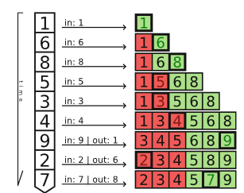
Incremental Percentile Filter (IPF) for class labels (relative cost)
w=6, b=50%
Keep ordered, windowed list of recent scores (size w)
Define relative budget b of acquisitions e.g. acquire one feature for 50% of the instances
Delete the oldest score when a new one arrives
Trigger an acquisition if an arriving score lands in the top b %
[Kottke, D. “Budget Optimization for Active Learning in Data Streams”.. Master’s thesis]

Slide 12
Incremental Percentile Filter (IPF) for class labels (relative cost)
Keep ordered, windowed list of recent scores (size w)
Define relative budget b of acquisitions e.g. acquire one feature for 50% of the instances
Delete the oldest score when a new one arrives
Trigger an acquisition if an arriving score lands in the top b %
w=6, b=50%
Budget use
50%
time
[Kottke, D. “Budget Optimization for Active Learning in Data Streams”.. Master’s thesis]

Slide 13
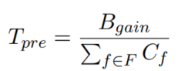
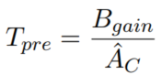
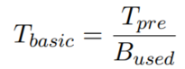
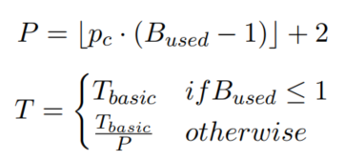
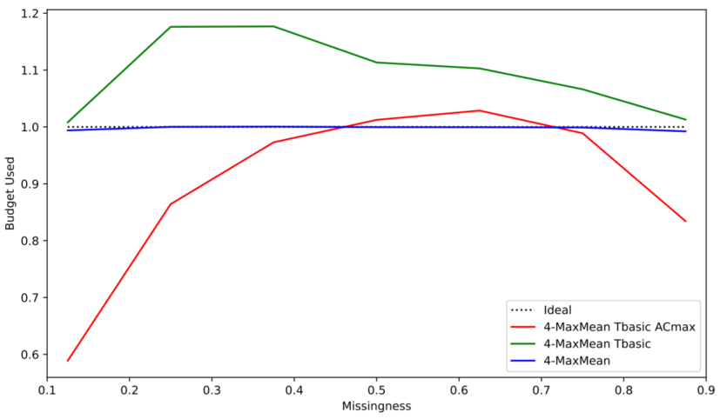
Modelling absolute costs and defining an IPF threshold
Budget becomes available incrementally (B_gain)
budget spent / budget received=1
Set initial threshold by either assuming maximum or average cost
Adjust based on used budget
Add penalty to handle overspending
Notes:
Preferred option using average (estimated number of missing features per instance times average feature costs) Budget becomes incrementally available Curves drop of becaue of maxmean strategy (best feature missing is more likely)

Slide 14
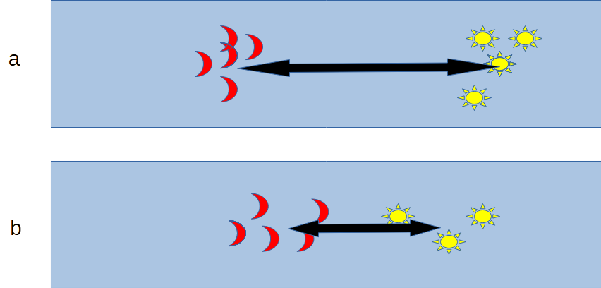
Scoring missing features in a data stream
Mostly relied on Average Euclidean Distance
Use window of past instances to calculate the mean value of each feature given a class
The further apart the higher the importance
Merit = importance / cost
[Yuan, Lanqin, Pfahringer, Bernhard, and Barddal, Jean Paul. “Iterative subset
selection for feature drifting data streams”. In: Proceedings of the 33rd Annual ACM Symposium on Applied Computing, SAC 2018, pp. 510–517. ]
Notes:
Cost are absolute and not normalized

Slide 15
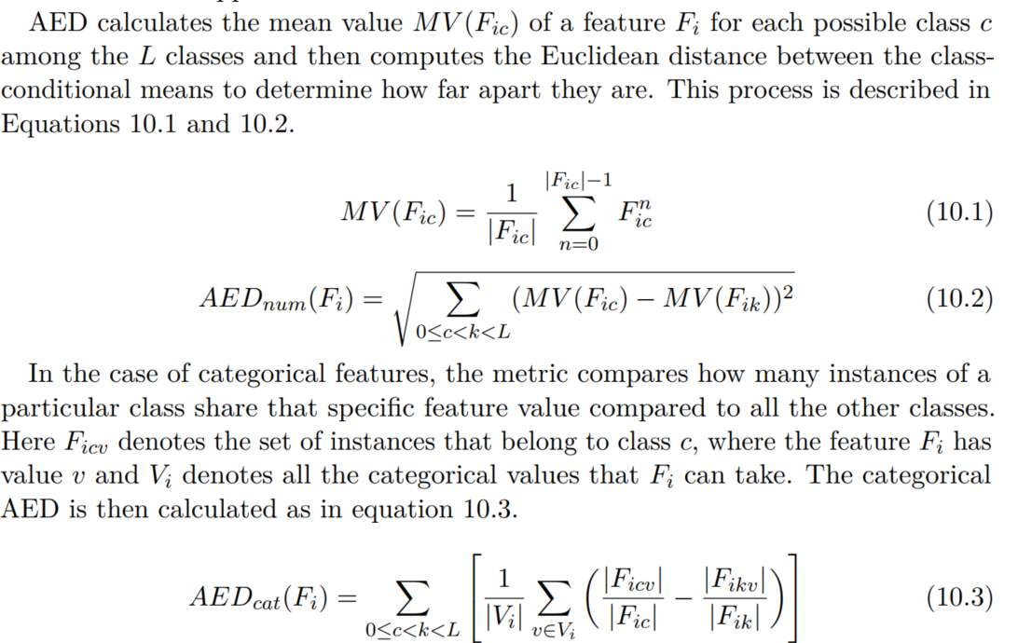
AED

Slide 16
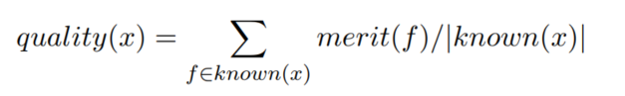
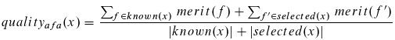
Scoring an instance with missing features in a data stream
Calculate merits of all features
Sum up merits of available features and divide by number of features to get the current instance quality
Calculate quality after acquisition selection
Use the quality (gain) as the score that is presented to the IPF
[1] Beyer, C., Büttner, M., Unnikrishnan, V. et al. Active feature acquisition on data streams under feature drift. Ann. Telecommun. 75, 597–611 (2020)
[2] Büttner, Maik, Beyer, Christian, and Spiliopoulou, Myra. “Reducing Missingness in a Stream through Cost-Aware Active Feature Acquisition”. In: 2022 IEEE 9th International Conference on Data Science and Advanced Analytics (DSAA).
Notes:
Dividing by number of available features is necessary so that we don’t only fill up almost complete instance which would have a high base quality
Quality can not distinguish between an instance that has the best feature missing and second best available and an instance which has the second best available and best missing as resulting quality if we add the best feature would be the same but the quality gain would be different

Slide 17
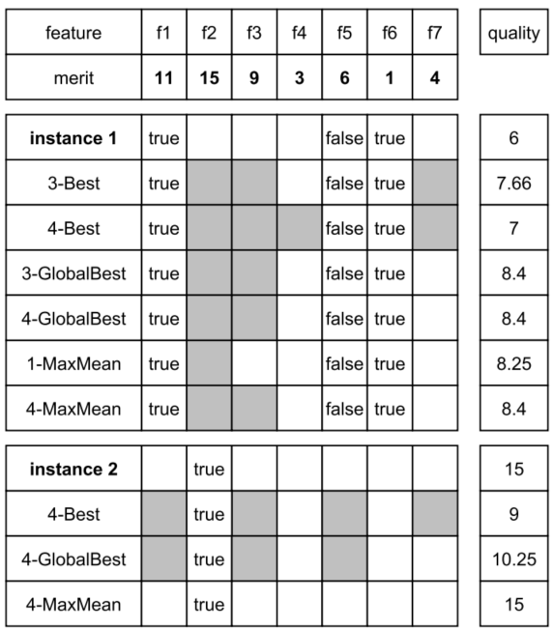
Acquiring multiple features per instance
k-Best missing of the instance
k-GlobalBest irrespective of missing features of the instance
k-MaxMean, adds up to k while quality of instance improves
Notes:
Preferred option using average (Bgain/ (average feature cost * k/2))

Slide 18
Summary
Get budget for AFA for each arriving instance (B_gain)
Estimate current feature merits based on predictive power and costs
AFA-strategy selects potential features for acquisition
Potential gain in quality is calculated (quality_gain)
Budgeting mechanism (IPF) decides whether acquisition goes through based on quality gain
Rest of missing features are imputed (numerics: mean, categorical: mode)

Slide 19
Example on mixed_5k_shift.csv
2 num and 2 cat features
1st 5k instances class = 1 if x > 0.5
2nd 5k instances class = 1 if color=‘red’

Slide 20
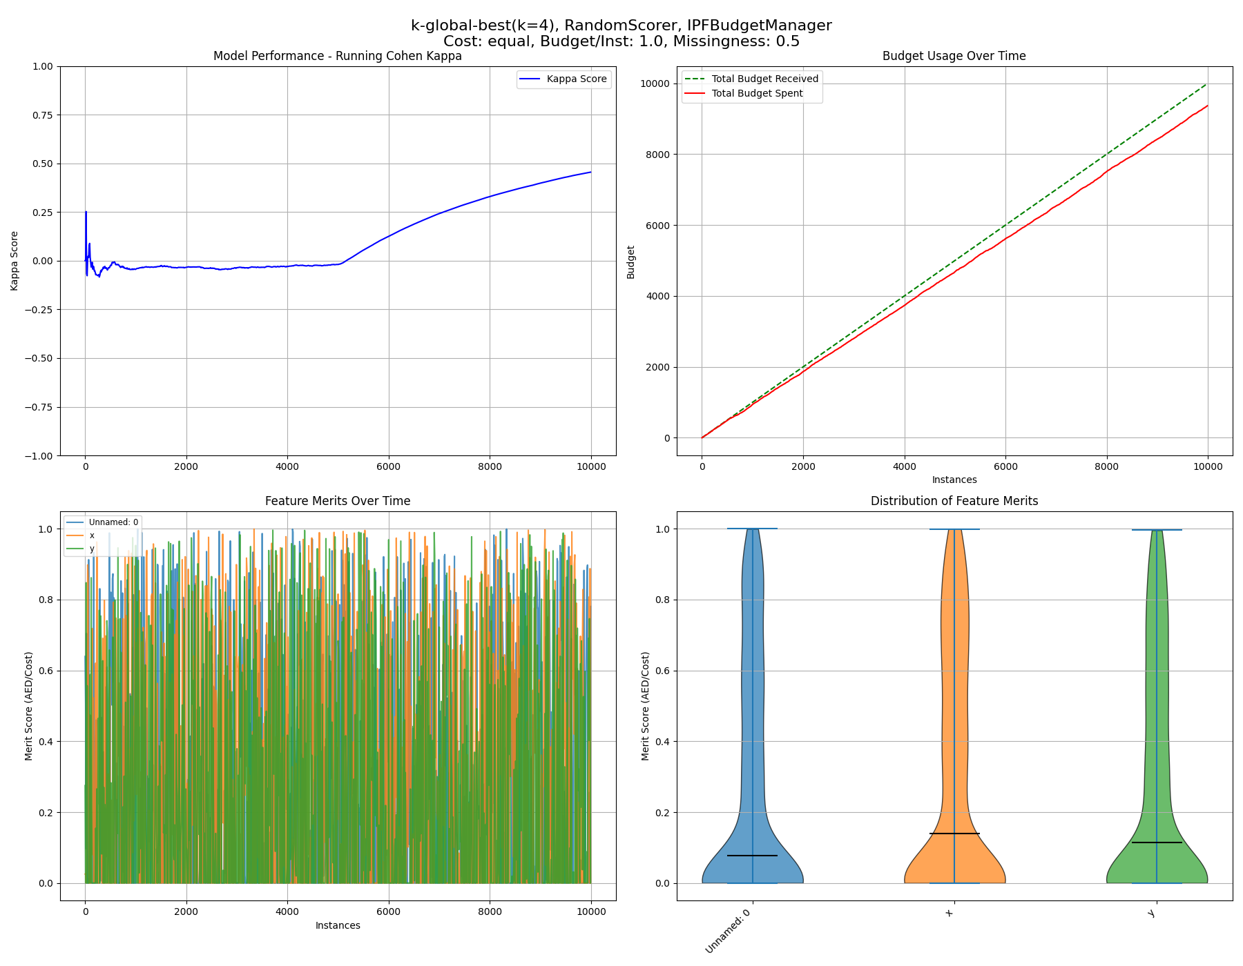
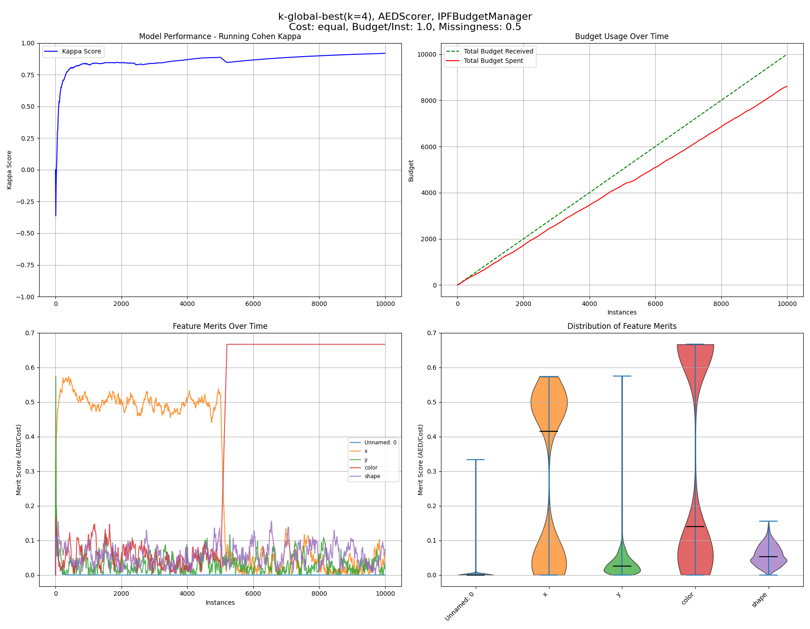
Example on mixed_5k_shift.csv AED features scores

Slide 21
Example on mixed_5k_shift.csv random features scores

Slide 22
References
[1] Beyer, C., Büttner, M., Unnikrishnan, V. et al. Active feature acquisition on data streams under feature drift. Ann. Telecommun. 75, 597–611 (2020) [2] Büttner, Maik, Beyer, Christian, and Spiliopoulou, Myra. “Reducing Missingness in a Stream through Cost-Aware Active Feature Acquisition”. In: 2022 IEEE 9th International Conference on Data Science and Advanced Analytics (DSAA). [3] Büttner, Maik, Beyer, Christian, and Spiliopoulou, Myra. “Joining Imputation and Active Feature Acquisition for Cost Saving on Data Streams with Missing Features”. In: International Conference on Discovery Science. Springer. 2023, pp. 308–322.

Slide 23
Thank you!

Slide 24
Backup slides

Slide 25

Motivation for active feature acquisitions (AFA)
AFA on streams is new but many scenarios have stream properties
Concept drift can affect feature distributions and their importance
Intelligent budget usage is beneficial for stakeholders
[https://toplabdirect.com/patient-services/blood-work/]

Slide 26
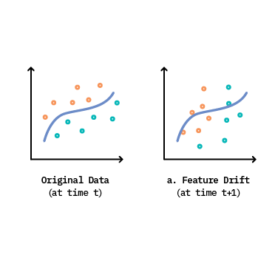
Motivation for active feature acquisitions (AFA)
AFA on streams had not been considered but many scenarios have stream properties
Concept drift can affect feature distributions and their importance
Intelligent budget usage is beneficial for stakeholders
[https://concept-drift.fastforwardlabs.com/]

Slide 27

Motivation for active feature acquisitions (AFA)
AFA on streams had not been considered but many scenarios have stream properties
Concept drift can affect feature distributions and their importance
Intelligent budget usage is beneficial for stakeholders
[https://www.shiksha.com/online-courses/articles/smart-budgeting-approaches-that-you-must-know/]

Slide 28
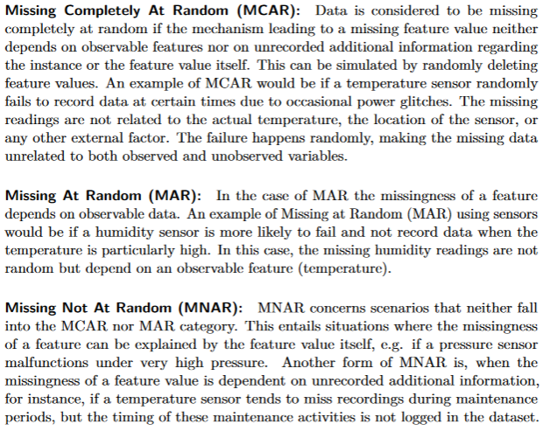
Types of missingness

Slide 29
Budgeting in a static scenario
Static, pool-based active learning requires a scoring function (based on the ML model)
It iteratively acquires missing data and updates the model with the true values until all budget is spent
Budget modelled as real costs or number of instances that can be labeled
[https://www.semanticscholar.org/paper/Active-Learning-Literature-Survey-Settles/818826f356444f3daa3447755bf63f171f39ec47/figure/0]
Notes:
Maybe move to backup

Slide 30
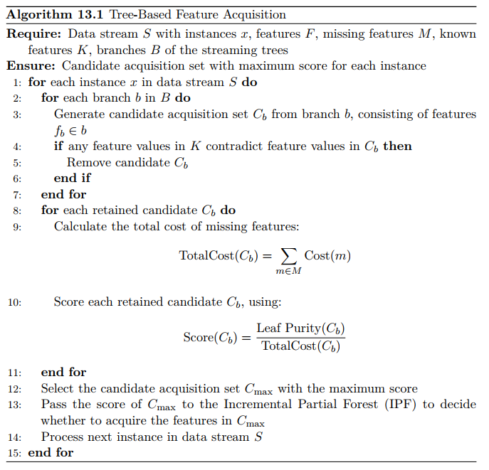
Tree AFA

Slide 31
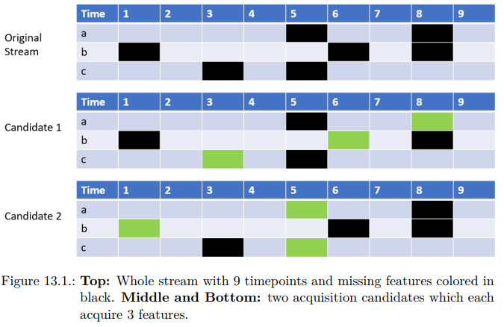
Budget-sensitive baseline with GA

Slide 32
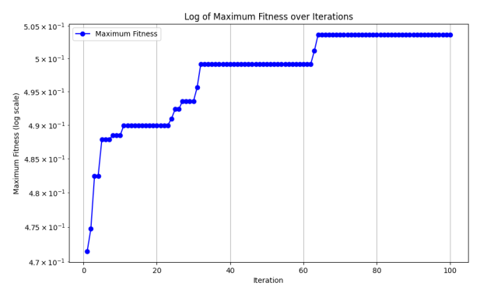
Budget-sensitive baseline with GA

Slide 33
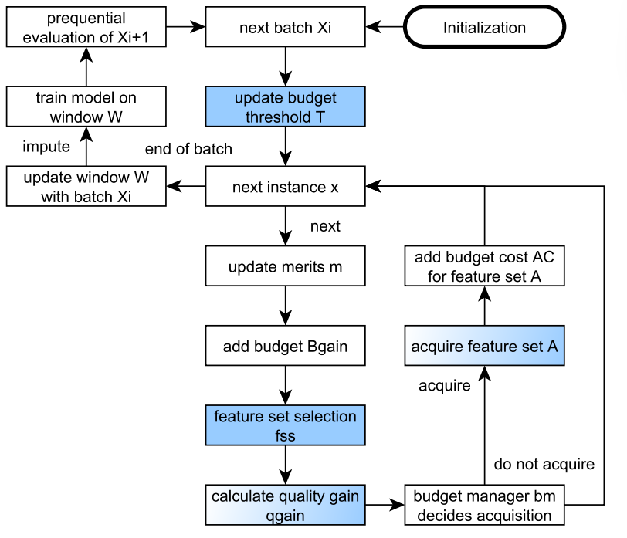
Framework AFA 2
Notes:
Update Threshold after batch so that it doesn’t fluctuate too much but more research needed when would be a good time

Slide 34
AED

Slide 35
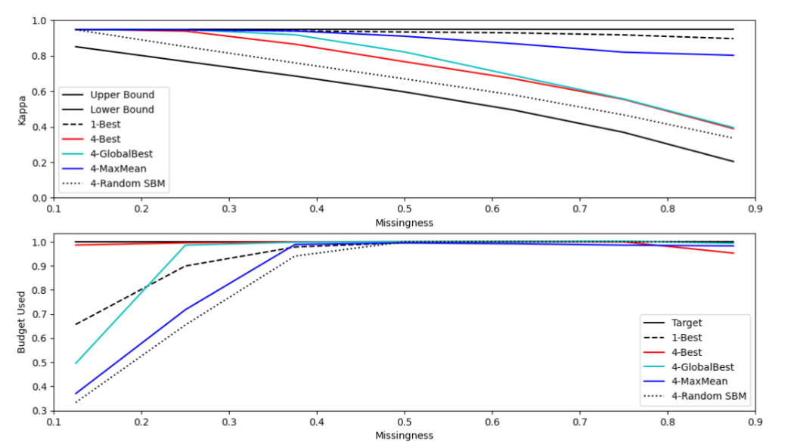
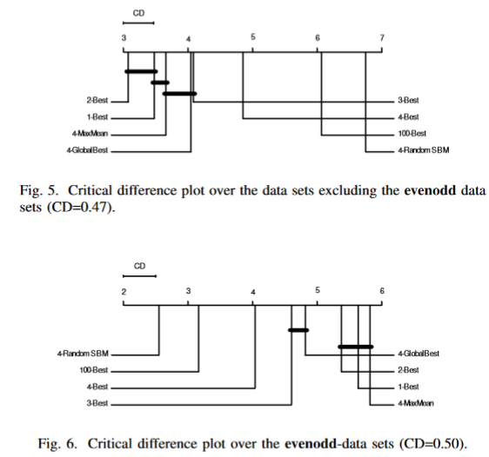
Cost aware AFA vs. random acquisition
Low budget occupancy
Notes:
Occupancy

Slide 36
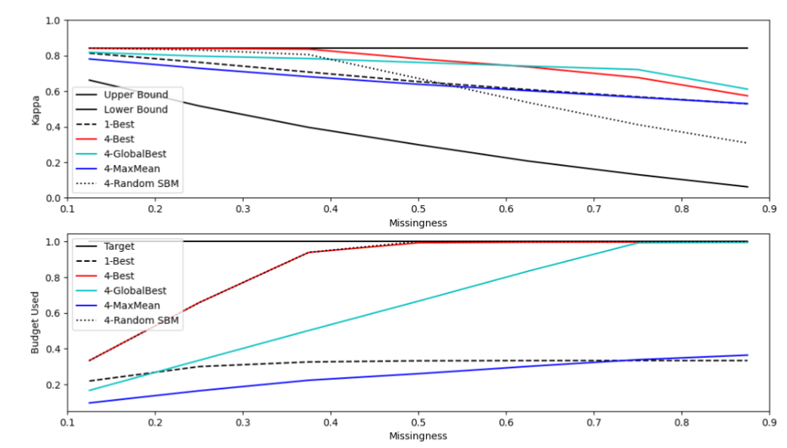
Underspending in high budget nursery dataset

Slide 37
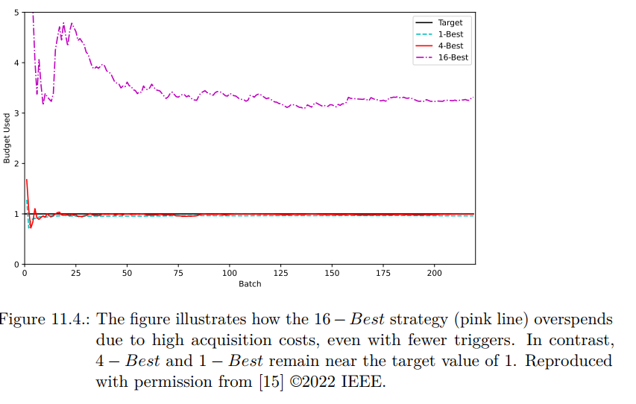
Forced overspending

Slide 38
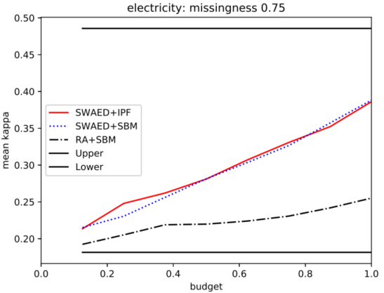
Same cost and one feature per instance
Allows for relative definition of budget e.g. purchase a features for 10% of the instances that have a feature missing
Compared against a random baseline with simple budget management
Adds best missing feature according to merit to an instance and calculates new instance quality
Instance quality is directly handed to the IPF

Slide 39
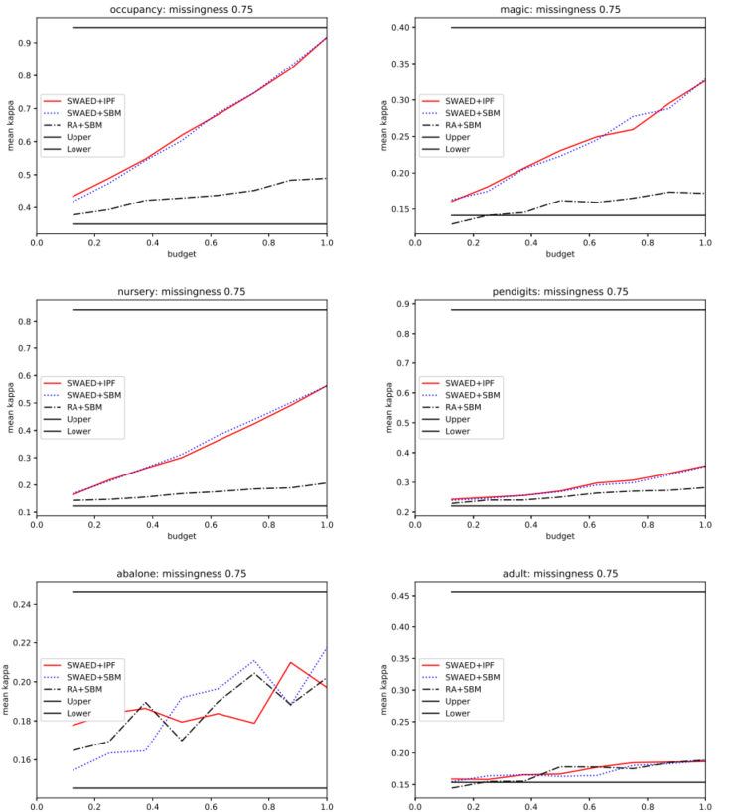
AFA 1 static datasets

Slide 40
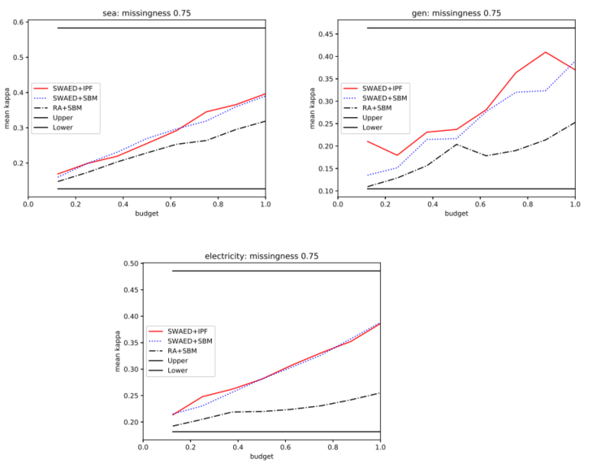
AFA 1 stream datasets

Slide 41
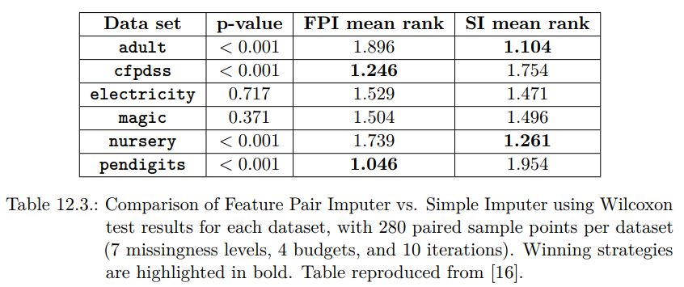
Better imputer needed

Slide 42
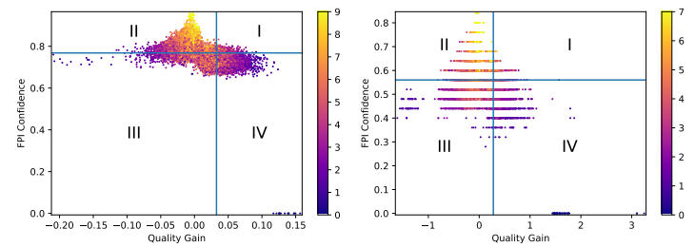
Hybrid approach saving potential

Slide 43
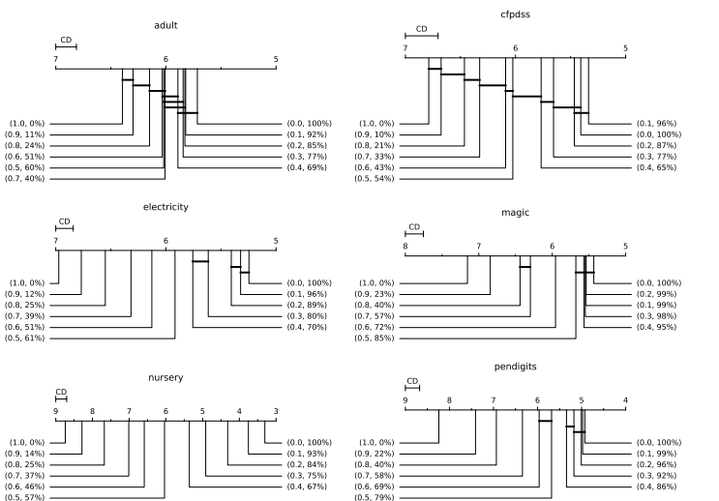
Budget save

Slide 44
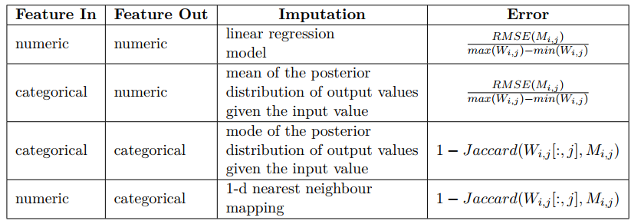
FPI conf 1
Notes:
Max Wi,j is max value in window of features I and J

Slide 45
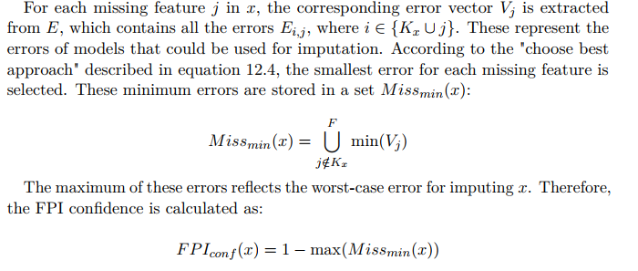
FPI conf selection
Notes:
Select for each missing feature best model(min V_j) to impute and store the error 1-max of these errors (Intuition that imputation as at most as good as worst construction, alternative weighted approach (not implemented)) Here issue is that errors don’t scale the same based on definition but have same range

Slide 46
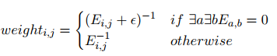
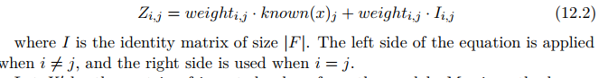
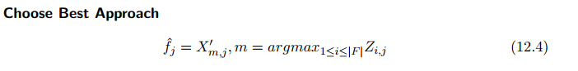
FPI conf imputation
Pick the imputation of model with smallest error (highest weight)
Notes:
Inverse of error as weight so that smaller error gets higher weight Z is weight matrix (left side would be zero if same feature as j is unknown so mask is 0)

